Slide 1
Multi-Input
TRANSLATOR
- By Phyliss, Kelsey, Yuxuan, and Bao (Group 18)
Notes:
Everyone

Slide 2
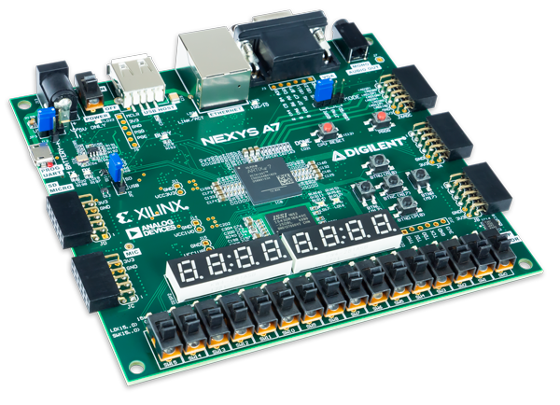
Overview
Designing a compact messaging system using switches for character input, a select and enable button to confirm/delete a character, accelerometer tilt inputs to control character position, and final VGA display to monitor
Notes:
Bao

Slide 3
Goal/Motivation
What We’re Doing:
Designing a compact, hardware-efficient messaging system.
Providing a simple way to input, edit, and store characters, displaying them dynamically on a VGA screen in real-time.
Why It Matters:
Offers an intuitive input method using minimal hardware, replacing traditional keyboards or controllers in specific contexts.
Demonstrates a flexible, space-saving input system for environments with limited hardware resources.
Real-Life Application Example:
Compact remote input device for kiosks or public systems.
Example: Users input names or short messages (e.g., for displays, ticketing systems, or interactive kiosks).
Notes:
Phyliss
Initial Idea:
The project started as a tilt-based input system, exploring novel ways of character selection through accelerometer data.
Due to implementation challenges, the input system pivoted to switches and buttons for more stability and control.
Compact and Efficient Design:
By focusing on real-time character display and minimal hardware, the project showcases the feasibility of compact messaging systems.
The small hardware footprint makes it ideal for embedded applications or public use cases like kiosks.
Example:
Imagine a kiosk at a conference or event where attendees can input their names using switches and buttons.
Their name is immediately displayed on a VGA display, replacing the need for bulky keyboards or touchscreens.

Slide 4
Functionality
Core Features:
Dynamically display letters on a VGA screen using bitmap representations of ASCII characters.
Support letter insertion (en) and deletion (del) with switch-based input.
Move a cursor-like marker to highlight the active position.
Key Focus:
A simple, real-time system for character input,
deletion, and VGA display.
A
B
C
Notes:
Kelsey
VGA Display:
The system takes ASCII binary values, converts them to characters using predefined bitmaps, and renders them dynamically on the VGA display.
Each character is displayed at one of three fixed buffer positions, ensuring clarity and usability.
User Interaction:
Switch-based inputs allow users to select letters, confirm their addition, or delete them from the buffer.
The cursor highlights the current active position, making it easy for users to understand where the next action will apply.
Real-Time Behavior:
All inputs are processed in real-time, with immediate feedback on the VGA display.
The simple, intuitive design ensures that users can interact with the system without delay or confusion.

Slide 5
Specification
Requirements:
Inputs:
Tilt input to select the active box for the next character.
Switches to input letters (A-Z for our implementation).
Delete button to remove the most recent letter.
Enable button to confirm a letter entry.
Buffer storage for up to 3 letters.
Outputs:
VGA display will render three characters using bitmap representations of ASCII values.
Constraints:
Memory limitations (3-character buffer only).
Switch-based manual input (no tilt or dynamic input).
VGA resolution constraints for rendering characters.
Precise timing requirements for VGA signal generation.
Notes:
Kelsey
Hardware Constraints:
Memory Limitations:
The system is designed to store up to three letters in the buffer. This keeps the design simple and fits within the memory constraints of the FPGA.
VGA Resolution Constraints:
The VGA output uses a fixed resolution (e.g can be 640x480 at 60 Hz), which limits the detail of the characters displayed.
Precise timing is required to maintain the VGA signal, as even minor timing errors can cause glitches or misalignment on the display.
Input Hardware Limitations:
The input system relies on switches and buttons for character selection, confirmation, and deletion.
While simple and stable, this input method lacks the flexibility and intuitiveness of a keyboard or dynamic input device.
Functional Constraints:
Manual Input Only:
Users manually toggle switches and press buttons to enter or delete letters, which is slower and less intuitive compared to tilt-based or keyboard input.
Static Display Features:
Characters displayed on the VGA are static in size and appearance, with no support for dynamic font scaling or advanced visual effects.
Original Design Pivot:
Tilt Functionality Constraints:
The original plan to use tilt input with an accelerometer faced challenges in simulation testing, including calibration issues, noise, and complexity.
To simplify the design and ensure stability, the team pivoted to a switch-based manual input system.
Timing Constraints:
VGA output requires precise timing signals to achieve a resolution of (eg) 640x480 at 60 Hz. Maintaining these strict timing requirements is crucial for proper rendering.

Slide 6
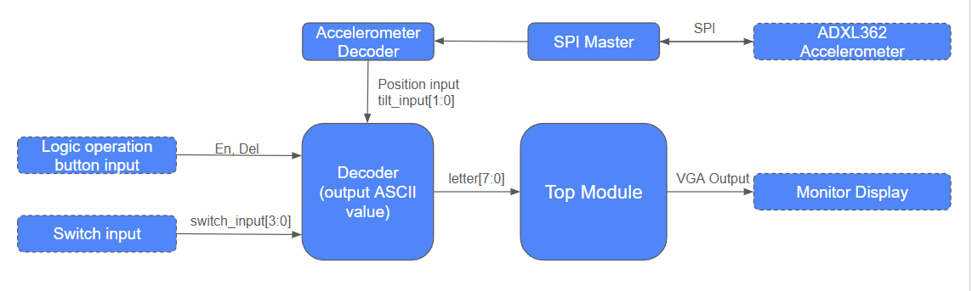
Block Diagram
Notes:
Bao

Slide 7
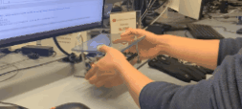
Successes
Able to use bitmap representations of ASCII characters to generate VGA display
Successful translation of ASCII binary values to ASCII characters
Implemented basic input logic
Able to read output data from accelerometer
Notes:
Bao

Slide 8
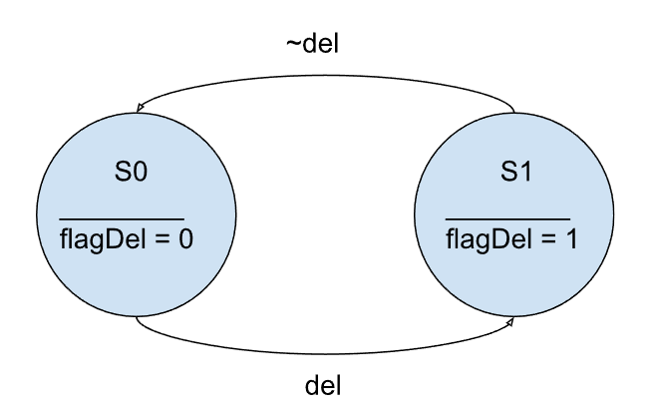
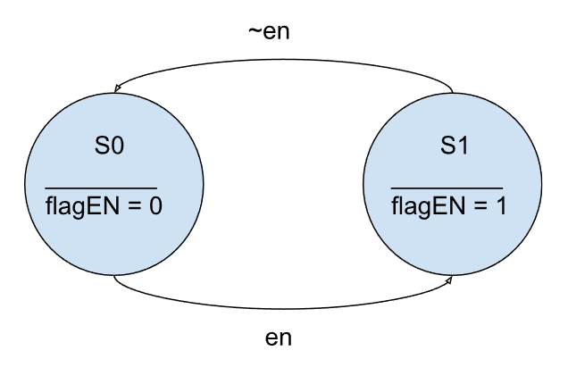
Logic Input
Challenge:
Input Signals:
Deleting or inserting characters can occur across multiple clock cycles when the input signal remains high.
Solution:
Using Flags:
Introduced flags (flagDel and flagEN) to ensure single deletions and insertions per signal activation.
Notes:
Yuxuan
Challenge Context:
The issue is that input signals (en, del) can stay high for multiple clock cycles, which the flip-flops interpret as multiple actions, leading to errors like deleting multiple characters instead of one.
How Flags Solve This:
The flags (flagDel and flagEN) act as debouncers by only transitioning states when the input changes. For example, the delete action (del) sets flagDel to 1, but it won't allow further transitions until del is released, preventing repeated deletions.
State Diagrams:
The diagrams show how the system transitions between states (S0 and S1). Each button press activates a flag (flagEN for enable, flagDel for delete), ensuring precise input handling.

Slide 9
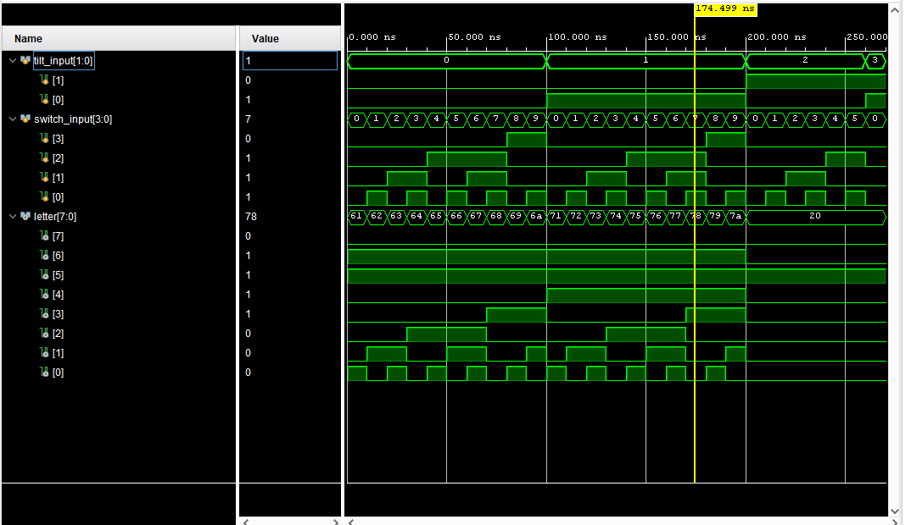
Decoder
Follows ASCII table, hardcoded a to z for now.
Notes:
Yuxuan

Slide 10
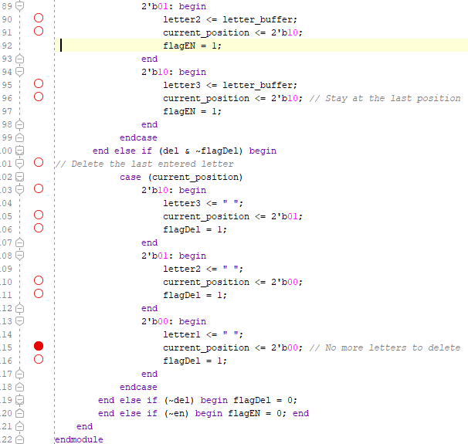
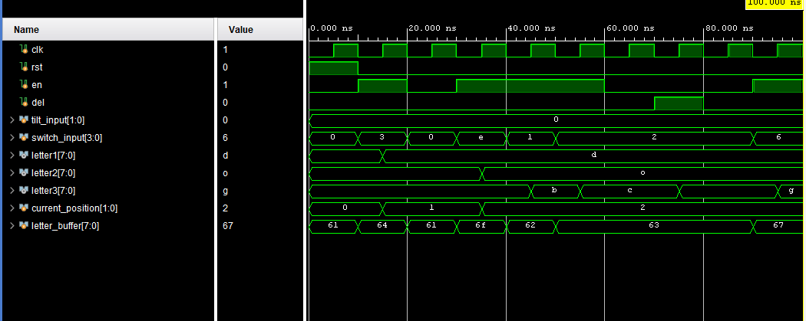
Decoder logic
Notes:
Yuxuan

Slide 11
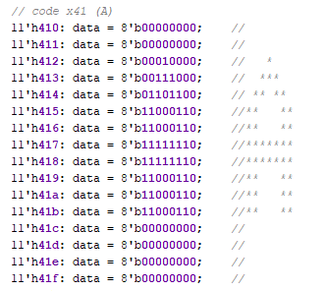
VGA Display
Letter encodings
Challenges: size of bmap and resolution of VGA controller
Multiple Approaches: hardcoded letters and expanded letters
A
Notes:
Kelsey

Slide 12
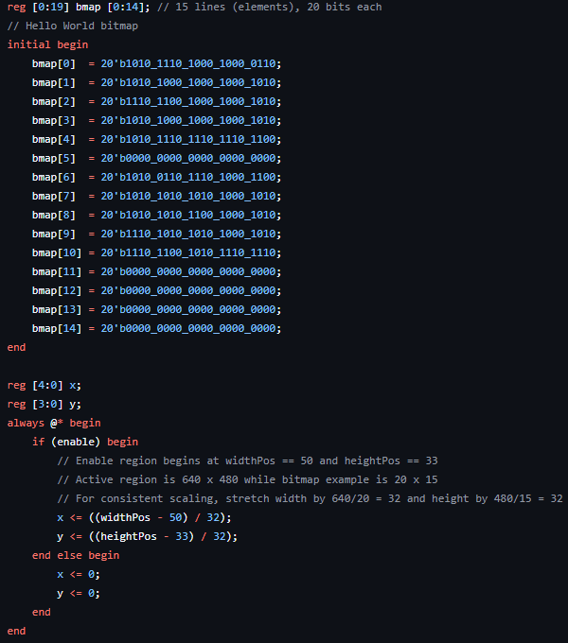

VGA Display (continued)
Scaling bitmap representation of “Hello World” to generate VGA output
Notes:
Bao

Slide 13
Alternate Implementation (Tilt Module)
Key Features:
Converts tilt values (x, y, z) to ASCII characters (A-Z).
Uses thresholds (X_THRES, Y_THRES, Z_THRES) and incremental steps (THRES_STEP) to map tilt ranges to letters.
Operates with a state machine:
IDLE: Waits for valid tilt input.
PROCESS_X/Y/Z: Determines character based on tilt axis and thresholds.
OUTPUT_LETTER: Outputs character (ascii_out) and asserts the valid signal.
How It Works:
Tilt input is checked against thresholds to identify a range.
Each range corresponds to a specific letter.
State transitions ensure proper output of the character.
Notes:
Phyliss
Purpose of the Tilt Module:
The tilt module translates accelerometer tilt values into letters A-M using thresholds and a state machine.
How Tilt Detection Works:
Tilt inputs (x, y, z) are compared to thresholds (X_THRES, Y_THRES, Z_THRES).
Incremental steps (THRES_STEP) help distinguish between tilt ranges, mapping each range to a unique letter.
State Machine Details:
IDLE: Constantly monitors tilt inputs. Transitions to PROCESS_X/Y/Z when a threshold is crossed.
PROCESS_X/Y/Z: Checks tilt against ranges and selects the corresponding ASCII character.
OUTPUT_LETTER: Outputs the selected character and sets valid = 1, signaling the character is ready.
Example Flow:
Input: x = 550, exceeds X_THRES → Maps to 'B' → Outputs ascii_out = 'B' with valid = 1.
Why It Matters:
The valid signal ensures downstream components (e.g., a buffer or VGA display) only act on finalized outputs.

Slide 14
Failures
Challenges:
XYZ tilt inputs caused unreliable character selection.
The system consistently defaulted to first letter due to multiple matches in the state machine's for-loops.
Threshold calibration in simulation was difficult, and state transitions caused timing issues.
Pivot:
Switched to button-based inputs for greater stability and control.
Other Observations (During Switch Implementation):
Deletion Logic:
In the testbench, the second deletion often failed because the flagDel state machine didn’t reset properly, blocking further delete actions.
Notes:
Phyliss
Challenges:
Tilt-Based Selection Issues in Simulation:
The accelerometer-based design was tested in Vivado simulations, and the system consistently defaulted to selecting the first letter ('A').
This occurred because the state machine’s for-loops in PROCESS_X, PROCESS_Y, and PROCESS_Z allowed multiple matches, overwriting the correct output.
Threshold Calibration Problems:
Simulating tilt detection required careful tuning of thresholds (X_THRES, Y_THRES, Z_THRES) to distinguish tilt ranges.
The threshold values often failed to consistently detect valid tilts, leading to unreliable outputs in the testbench.
Timing and State Transition Issues:
State transitions between tilt processing (PROCESS_X, PROCESS_Y, PROCESS_Z) and the output phase (OUTPUT_LETTER) caused timing mismatches.
These mismatches made it difficult to validate the output signal during simulation.
Hardware Setup Challenges:
The accelerometer wasn’t physically tested due to the complexity of setting up communication protocols and noise filtering.
Pivot to Button-Based Inputs:
The input system was redesigned to use switches and buttons due to challenges with simulating tilt-based inputs and the complexity of accelerometer hardware integration.
Switches provided reliable, stable inputs for character selection, while buttons handled deletion and confirmation.
Other Observations (During Switch Implementation):
Deletion Logic Issues:
In the testbench for the switch-based design, the first deletion worked fine, but the second deletion failed.
The issue was caused by the flagDel state machine not resetting correctly after the first deletion, blocking subsequent delete operations.
Buffer Management Complexity:
Switch-based inputs simplified input stability, but managing the buffer for adding and deleting letters introduced new challenges.
The current_position tracking logic required careful updates to ensure letters shifted correctly, especially when the buffer reached its limits.
Lessons Learned:
Testing and debugging input systems early in the design phase can save significant time.
Switches provided a simpler and more reliable method for input, but if tilt-based inputs were to be revisited, robust filtering and better state machine handling would be critical.

Slide 15
Citations and Resources
ASCII_ROM: Created by David J. Marion aka FPGA Dude
Project F: https://projectf.io/posts/racing-the-beam/
Nexys A7 Reference Manual: https://digilent.com/reference/programmable-logic/nexys-a7/reference-manual?srsltid=AfmBOooTf9fmbBJXkkVbX3Q9yLxFQurI2v2I_xBizHjNdD6rqfFJyH4J

